Slide 1
Data Structures (Lab-6)
Queues

Slide 2
Agenda for Today
What is Queue
Queue Applications
Queue Operations
Circular Queue
Queue Implementation using Arrays
Task

Slide 3
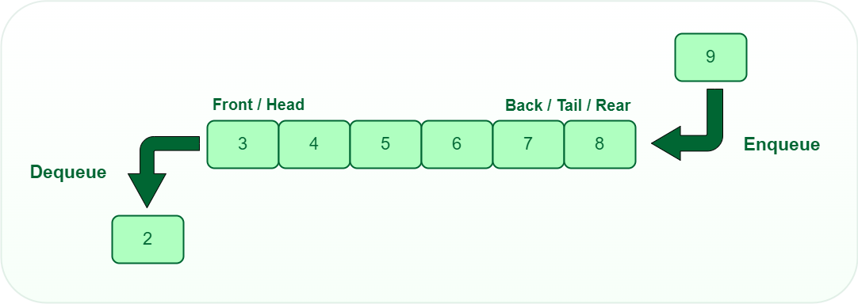
Queue
Visual Queue: https://www.cs.usfca.edu/~galles/visualization/QueueArray.html
FIFO
LILO

Slide 4
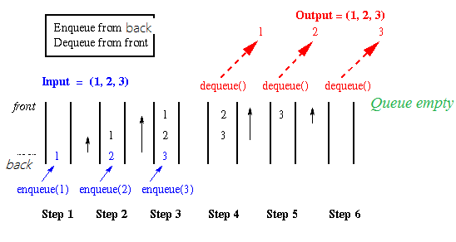
Queue in Action

Slide 5
Applications of Queue
CPU Scheduling and Task Management
Printers and Resource Sharing
Call Center Management and Customer Support

Slide 6
Queue Operations
enqueue()
dequeue()
isEmpty()
isFull()
front()
rear()
queueSize()
display()
etc.

Slide 7
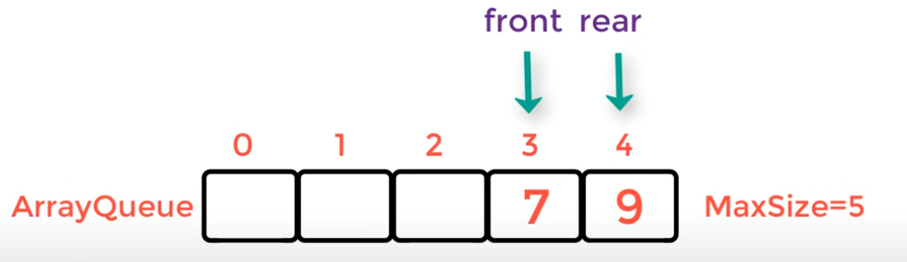
Queue Implementation Problem with Arrays
After a number of enqueue() & dequeue() operations, the rear/end/tail will always point to the end of the queue, indicating that the queue is full.
To solve this problem we will use the concept of Circular Queue
- Another problem is: fixed size of the queue.

Slide 8
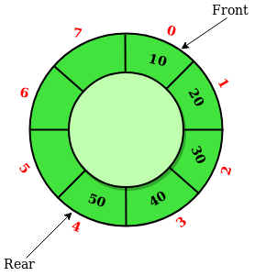
Circular Queue

Slide 9
Now, look at the Circular Queue implementation using Arrays. Check circulrQueueArray.cpp.

Slide 10
Let’s implement
First we need to create class queue that has members:
Size : int the max size you need
Front: int the first element in the queue
Rear: int the last element in the queue
List : array of int values(or any data type we need)
Parameterized constructor that take size parameter
Set size = the size you got from parameter
Set Front= 0 that refer to the first position will add elemets to it
Set Rear= maxSize – 1 that refer to the last position can add elemets to it
Create list it's size that you got from parameter

Slide 11
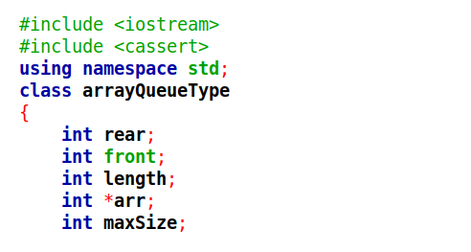
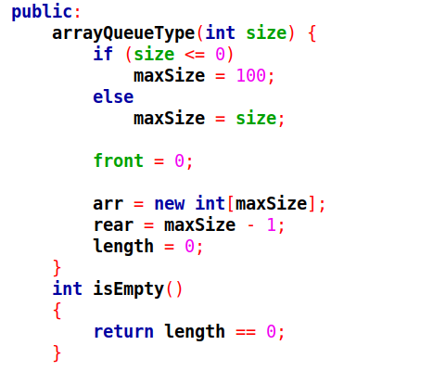

Slide 12
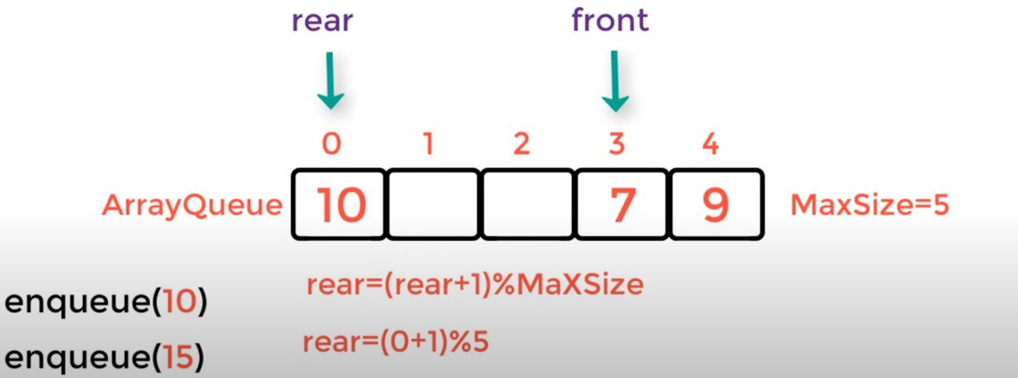
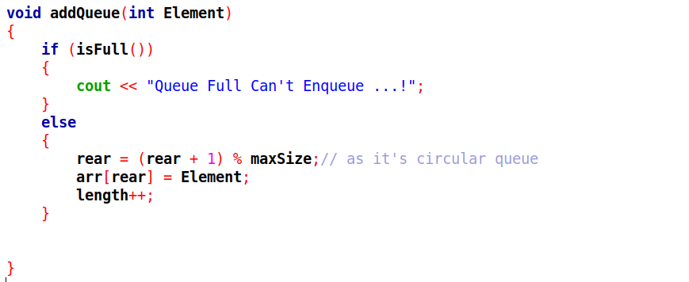
Circular Queue ( Enqueue)

Slide 13
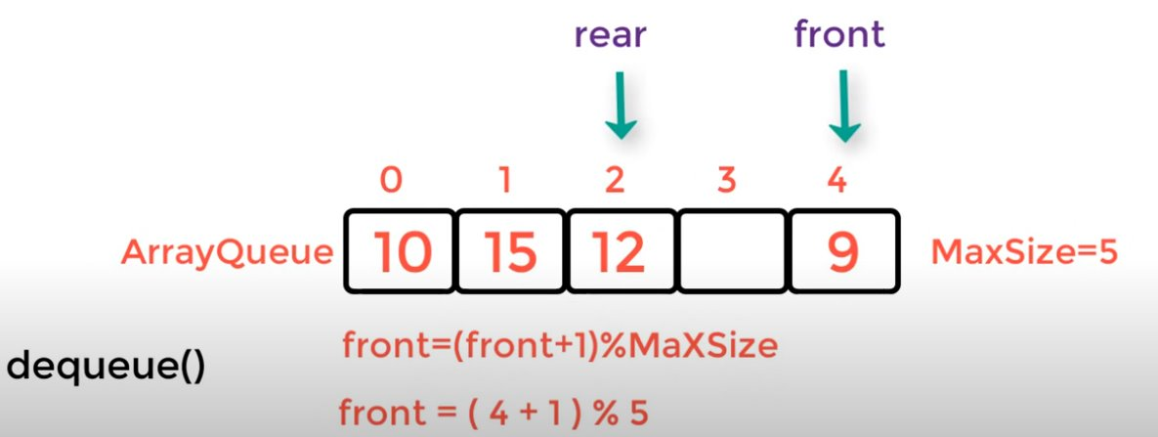
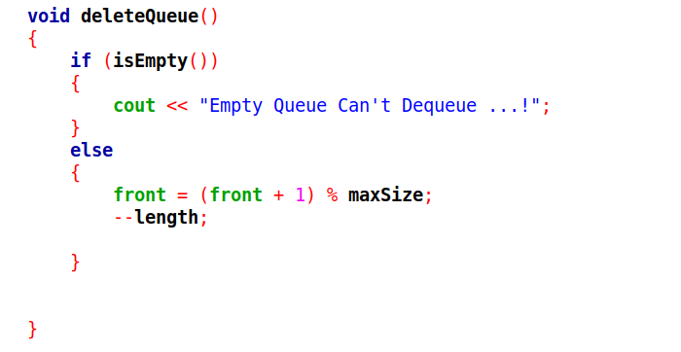
Circular Queue ( Dequeue)

Slide 14
Drawbacks of implementing queue using Array
Costly Resizing Operations
Inefficient Dequeue (Front Removal) Operation
Limited Capacity for Large Data

Slide 15
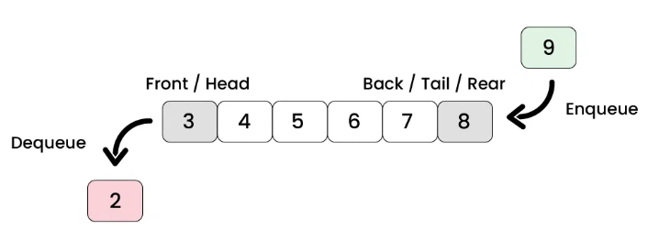
Queue using Linkedl list

Slide 16
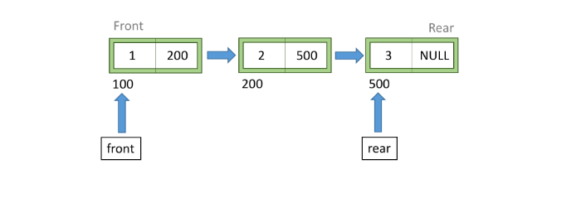
Queue using Linkedl list
Each item(node) in queue contains :-
A piece of data (any type)
Pointer to the next node in the Queue

Slide 17
Now, look at the Queue using linked list implementation using Arrays. Check QueueLinkedlist.cpp.

Slide 18
Let’s implement
First we need to create class queue that has members:
length: int the number of elemets in queue
Front: int the first element in the queue
Rear: int the last element in the queue
Default constructor
Set length= 0 as there is no ements in queue
Set Front,Rear= NULL

Slide 19
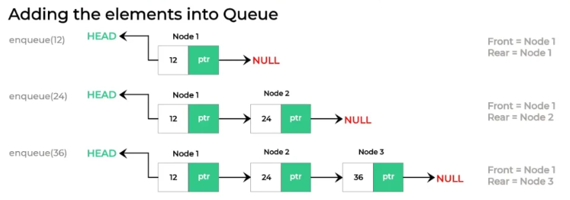
Queue ( Enqueue)
We add elements to the queue from the rear only

Slide 20
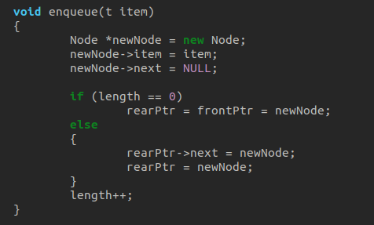
Check first if there is no nodes in queue
so the first node will be front&rear.
If not next of rear will point to new node
Rear will be the new point
Increament as there new node added

Slide 21
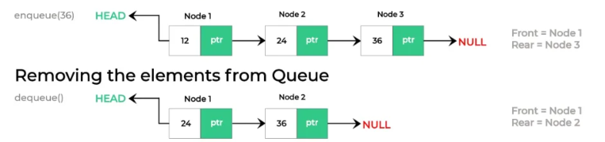
Queue ( Dequeue)
We remove elements from the front only

Slide 22
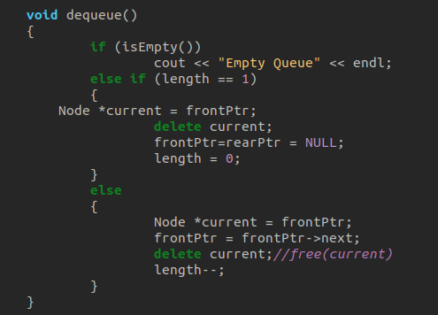
Check first if there is no nodes in queue
so deletion cannot be completed .
if there is one one so we deleted it and make front&rear=NULL.
If not we remove the front and make front next is the front
Decrement as there node deleted

Slide 23
Task
You have to implement a method to check if the queue elements are sorted in ascending order or not, if yes return true, else return false
Method Signature
bool sortedAscQueue()
Test Case
Queue q = [2, 3, 8, 12, 18, 33]
Result => true

Slide 24
Thank you.

